Slide 1
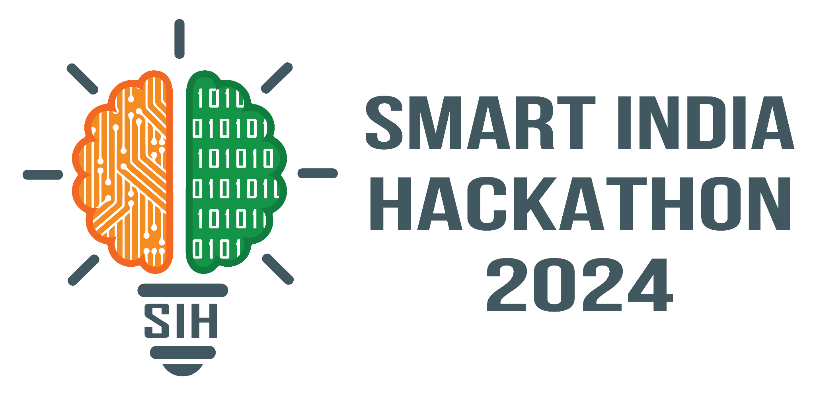

SMART INDIA HACKATHON 2024
Team:Byte Karma
KARTIK MALIK :2022UEI2803
ANSHUL ANAND :2022UEI2825
RIYA MEHTA :2022UEI2852
ANMOL SIKRI :2022UIC3573
ABHEENAV ARORA :2022UEC2640
ARYAN NARANG :2022UEI2836

Slide 2
Objective: AI-Enhanced Healthcare Diagnostics and Management System Inspired by ZK Medical Billing Platform
Problem:
Disjointed Patient Data:
Fragmentation: Patient data scattered across EHRs, labs, and imaging systems, leading to incomplete or inaccessible information.
Communication Gaps: Lack of integration hinders coordinated care and effective decision-making.
Inconsistent Diagnostics:
Human Error: Diagnosis accuracy varies due to reliance on individual expertise.
Delays: Manual processes cause diagnostic delays, affecting timely treatment.
Limited AI Integration:
Underutilization: AI's potential in automation and predictive analytics is underused.
Integration Challenges: Existing systems struggle to incorporate AI seamlessly, limiting its impact.

Slide 3
Need for Solution
Boosting Diagnostic Precision and Reliability:
Accurate Diagnostics: AI enhances diagnostic accuracy, reducing human error and ensuring consistent results.
Early Detection: AI identifies subtle patterns for early disease detection, improving treatment outcomes.
Integrating Patient Data Seamlessly:
Consolidated Information: Unified systems ensure comprehensive and current patient records.
Enhanced Collaboration: Better data integration supports effective communication and coordinated care.
Streamlining Healthcare Operations:
Process Automation: Automating tasks like billing and scheduling reduces errors and staff workload.
Optimal Resource Use: AI-driven analytics improve resource allocation and operational efficiency.
Preparing for Future Healthcare Needs: Scalability: AI systems can scale to meet increasing patient numbers and healthcare complexity. Long-Term Sustainability: Integrating AI ensures future readiness and system sustainability.

Slide 4
Proposed Solution
1. Comprehensive Patient Data Collection:
User-Friendly Form: Collects personal details, medical history, symptoms, lifestyle factors, and insurance info.
Data Integration: Transfers data to an Excel sheet for easy access and analysis.
2. ML-Driven Disease Prediction:
Advanced Analysis: ML model analyzes data to predict potential diseases.
Accuracy & Reliability: Utilizes large datasets and sophisticated algorithms.
3. Seamless Integration & Accessibility:
System Compatibility: Integrates with existing systems for smooth data flow.
Scalability: Handles large volumes of data, suitable for various healthcare environments.

Slide 5
Working
Our project is designed to streamline the diagnosis of minor medical conditions by leveraging advanced technology with a strong focus on accuracy and user experience. Users enter their personal details, including name, email, gender, age, medical history, past surgeries, and current symptoms, through a web interface built with HTML and CSS. This data is then processed by a machine learning clustering model that boasts an accuracy rate of over 95%, predicting the potential disease the patient may have.
The predicted disease is further analyzed by an AI/ML model leveraging Gemini API, which provides personalized lifestyle recommendations aimed at enhancing the patient's overall well-being. A comprehensive report, including the patient's personal information, the predicted diagnosis, and the suggested lifestyle changes, is generated using an integrated Overleaf and Google Collab system and downloaded automatically.

Slide 6
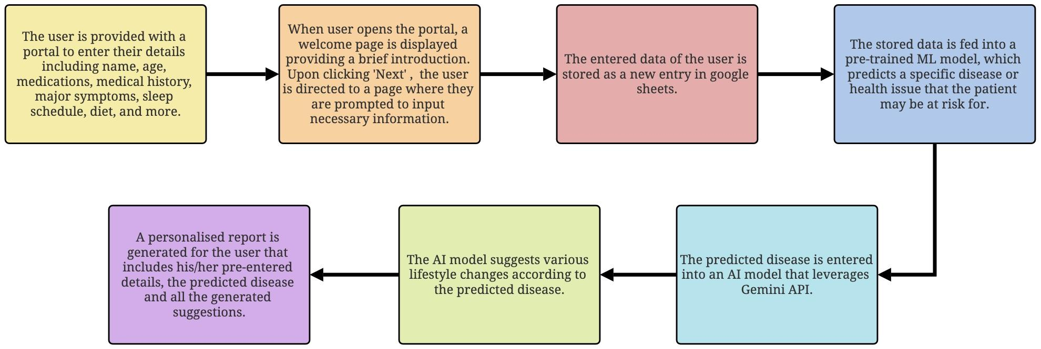
Flow Chart

Slide 7
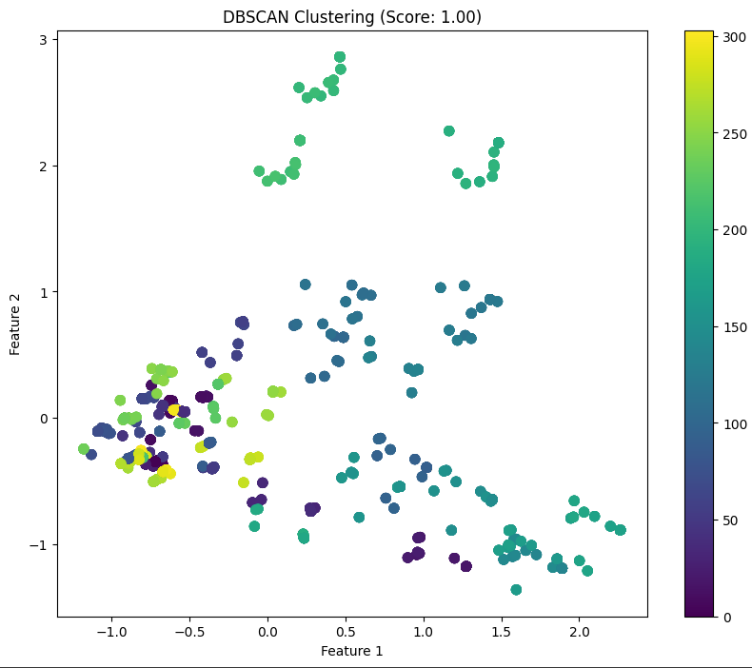
Trained Machine Learning Model Output

Slide 8
Business Model
1. Value Proposition
Accurate Diagnosis: Over 95% accuracy in predicting minor medical conditions.
Personalized Care: Tailored lifestyle recommendations using AI/ML and Gemini API
2. Key Activities Data Collection:
User inputs personal details and symptoms via a user-friendly web interface.
Machine Learning: Clustering model processes data to predict potential diseases.
AI Analysis: Further analysis of predicted disease and generation of lifestyle recommendations.
Report Generation: Automated creation of a comprehensive report via Overleaf and Google Colab.

Slide 9
3. Customer Segments Individual Users:
Patients seeking quick, accurate health assessments.
Healthcare Providers: Clinics and doctors integrating AI-driven diagnostics into their services.
Insurance Companies: Offering enhanced preventive care options for policyholders.
4. Revenue Streams
Subscription Fees: Monthly or annual subscriptions for ongoing access to diagnostic tools.
B2B Licensing: Selling the platform to healthcare providers and insurance companies.
Premium Services: Paid personalized reports, advanced diagnostics, and detailed health analytics.
5. Key Resources Technology Stack:
HTML/CSS for the web interface, ML models, AI/ML with Gemini API, Overleaf, Google Colab.
Data: Patient input data, historical medical records, and AI-driven insights.
Partnerships: Collaborations with healthcare providers, API providers (like Gemini), and tech partners.

Slide 10
Summary
Our project aims to enhance the diagnosis of minor medical conditions through advanced technology. Users input their personal details and symptoms via a web interface built with HTML/CSS. This data is processed by a machine learning model with over 95% accuracy, predicting potential diseases. Predictions are further analyzed using the Gemini API, which provides personalized lifestyle recommendations. Comprehensive reports, including personal information, diagnosis, and lifestyle suggestions, are generated and downloaded via Overleaf and Google Colab. The business model focuses on high accuracy and personalized care, generating revenue through subscription fees, B2B licensing, and premium services. Target customers include individual users, healthcare providers, and insurance companies. Key resources include the technology stack, data, and strategic partnerships. Customer engagement is supported through 24/7 online support and integration with existing systems.

